Slide 1
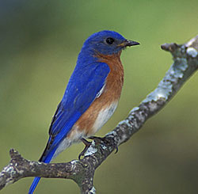
Local vs. Large Scale Gradients of Species Diversity in Birds
Student names removed for anonymity
BY222

Slide 2
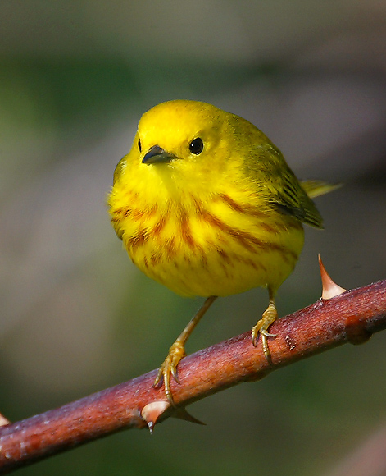
Objectives
Local, Regional, Continental comparisons
  Species richness
  Land coverage
    Patterns
  Land use
East coast to interior Colorado
Yellow Warbler, Fishman Island, Virginia

Slide 3
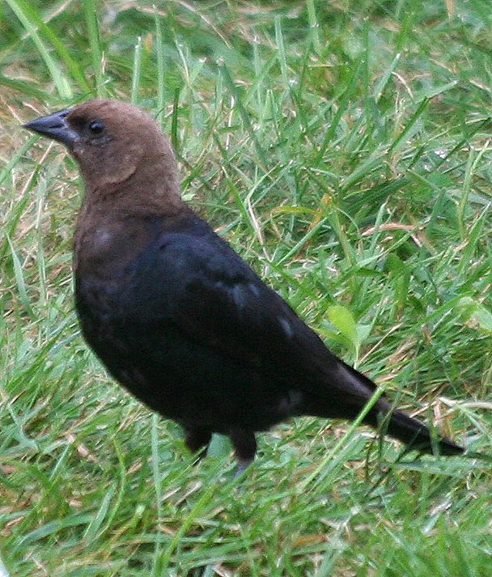
Hypotheses
Continental:
The further East, the greater the species richness of birds
Regional
There will be a greater species richness in birds where there is more water
Local
There will be more species in forested areas.
Brown-Headed Cowbird Squaw Creek, Missouri

Slide 4
Our Measurements
Latitude: 30° N to 40°N
Longitude: -75°W to -105°W
Field measurements: ≈3, 5 minsw/ 25, 50, 100m
Type: State Wildlife Management Area
Data collected: Avg of up to 5yrs
Breeding Birds
Local scale: 0.82km^2
Regional Scale: 52km^2

Slide 5
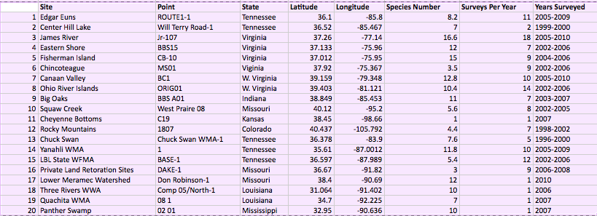
Breeding Birds Species Richness

Slide 6
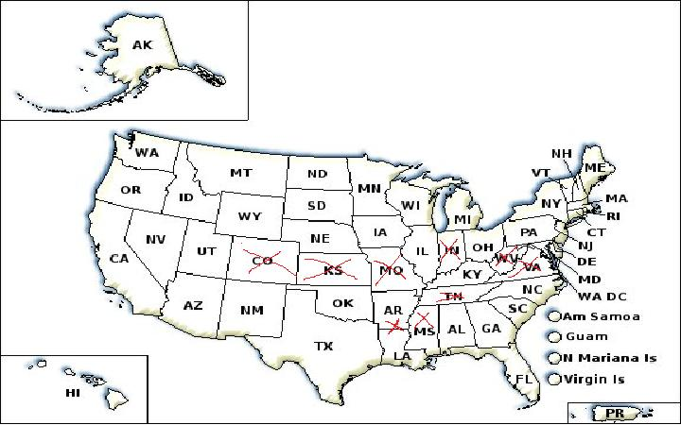

Slide 7
Species Richness vs Longitude

Slide 8

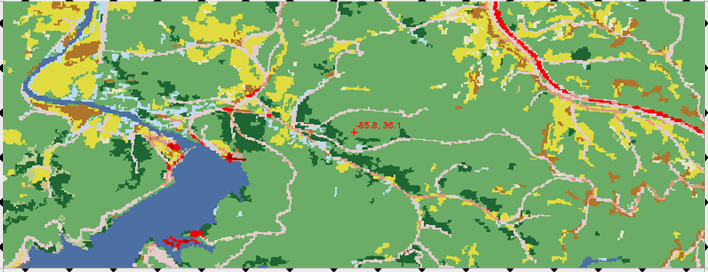
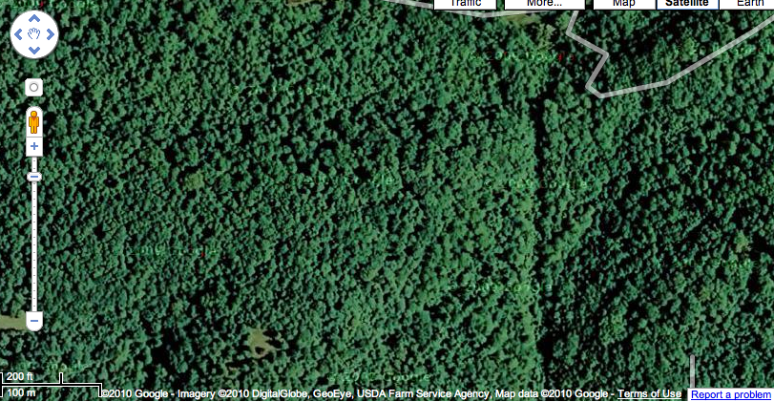
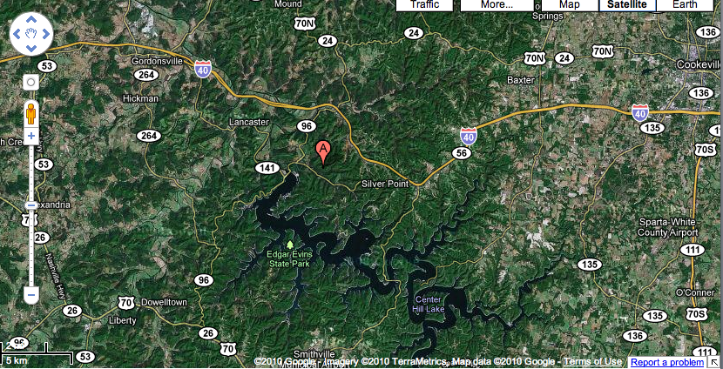
Tennessee Edger Euns

Slide 10
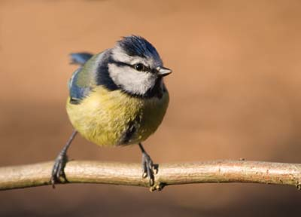
Conclusions
Continental scale bird species increase closer to the coast
Regional and local patterns show similar species richness

